Slide 1
IBM Data Science Capstone Project
Battle of Neighborhoods in the province of Alberta Canada for next Asian restaurant

Slide 2
Introduction and Business Problem
Nowadays every business owner has a dream of expanding his/her business globally. The business analysts helping these companies start with the largest cities in the country of destination then as the business starts its profitability they go after smaller cities in the same country. What they do is that they fist look for the neighborhoods of the target city. Then analyze each neighborhood to find out where is the best spot for them to establish new branches of their business.
I own an Asian chain restaurant that has been around in several major cities across the glob with more than 1000 branches. The company wants to expand its branches to more major cities in the world. Their plan is for the first phase to go for cities with a population of above one million and in the next phases focus on smaller cities. The project manager asked me to investigate cities with a population of above one million in the province of Alberta, Canada to find out where are the best neighborhoods to establish their new branches.
In the province of Alberta, there exist two cities with the criteria of having population above one million. These two cities are Edmonton and Calgary. Thus, in this project I will be using Foursquare location data to find out which neighborhoods are the best choice in Edmonton and Calgary to establish new branches.

Slide 3
Target Audience
The audience of this project is the Asian chain restaurant who is looking for expanding its branches in major cities in the province of Alberta, Canada.
Data Overview
To investigate the neighborhoods in two major cities of the province of Alberta Canada, we need to acquire six sets of data:
List of the neighborhoods in Edmonton
This set of data must be retrieved from Wikipedia webpage.
Geographical location of each neighborhoods in Edmonton
I use Georecorder package in python to export this set of data.
Venue data including the existing venues in each neighborhood in Edmonton
I use Foursquare to retrieve venue data.
List of the neighborhoods in Calgary
This set of data must be retrieved from Wikipedia webpage.
Geographical location of each neighborhoods in Calgary
I use Georecorder package in python to export this set of data.
Venue data including the existing venues in each neighborhood in Calgary
I use Foursquare to retrieve venue data.

Slide 4
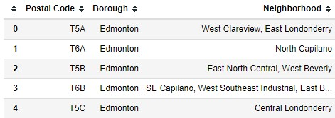
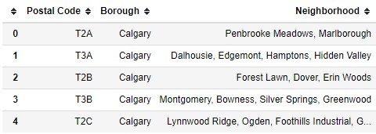
Retrieval of the data
In the first step all the data were retrieved from different web sites and packages to prepare the first data frames.
Below you can see an example of tables exported from Wikipedia website
Edmonton Neighborhoods
Calgary Neighborhoods

Slide 5
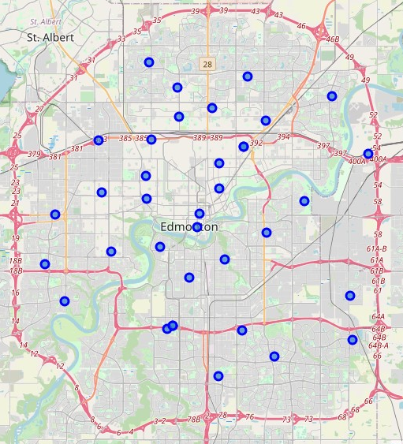
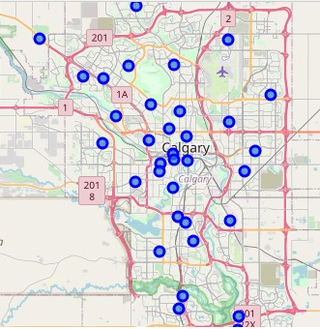
Map of Edmonton and Calgary before clustering
The figure below shows map of Edmonton and Calgary with the centroid of each neighborhood highlighted.
Edmonton
Calgary

Slide 6
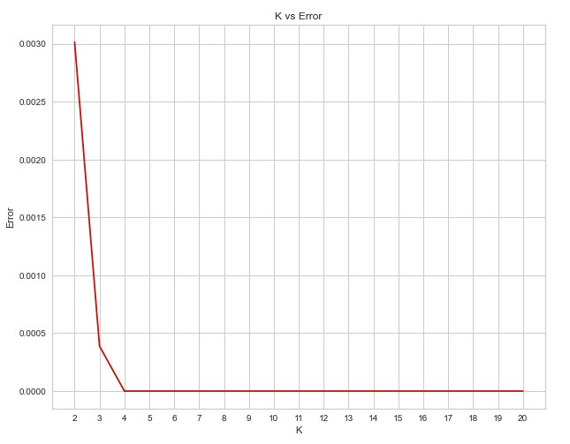
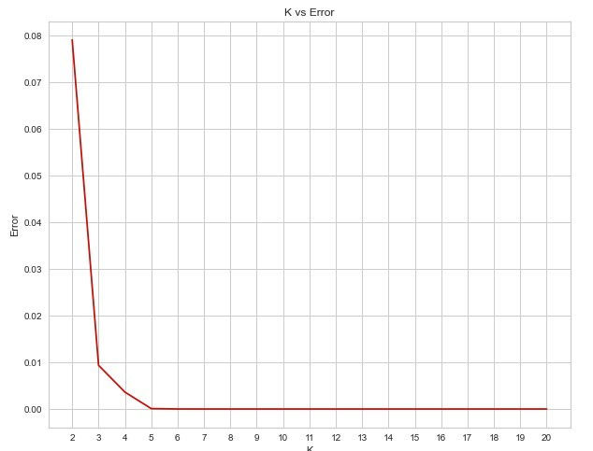
Finding the best K for Kmeans clustering
Using elbow point technique I find the best K to use in the Kmeans clustering algorithm to cluster neighborhoods in Edmonton and Calgary.
As shown in the figures below, the best K for both of the cities is equal to 4.
Edmonton
Calgary

Slide 7
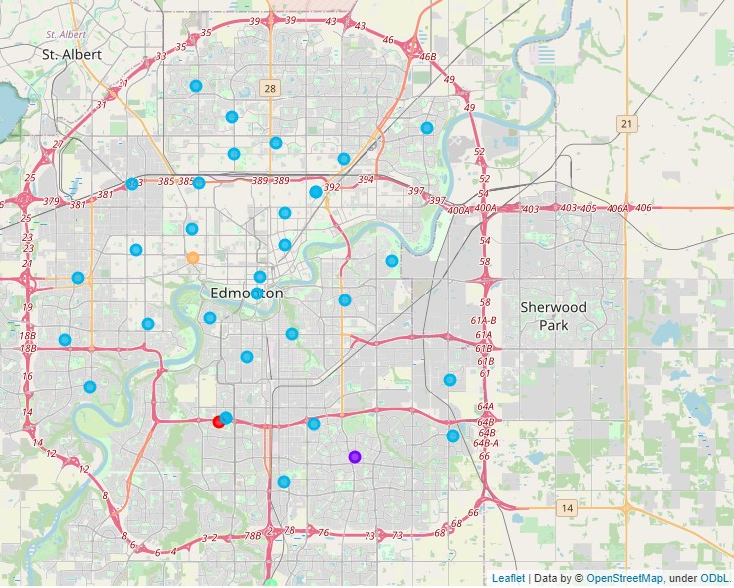
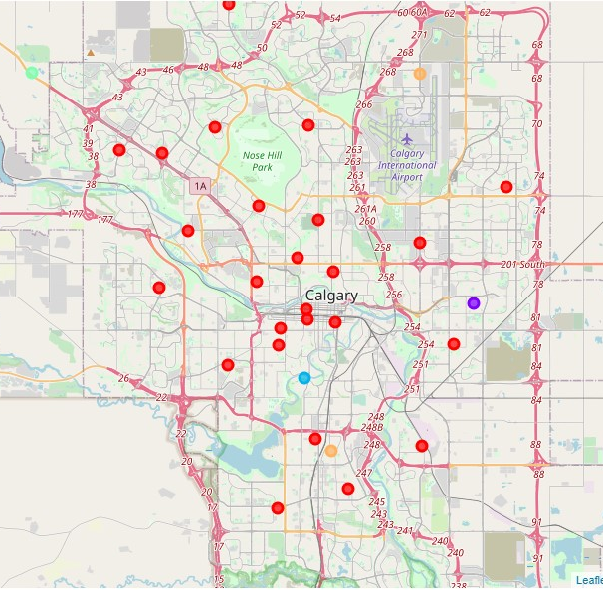
Map of Edmonton and Calgary with color coded centroids
4 clusters exists in each city that are shown in figure using different colors.
Edmonton
Calgary

Slide 8
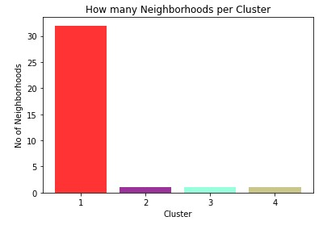
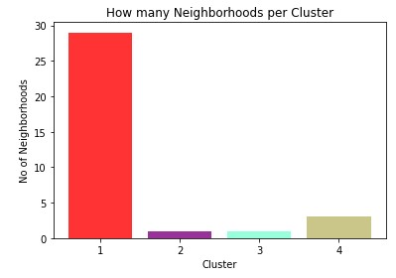
Number of Neighborhoods in each cluster
in Edmonton there are 32 neighborhoods in cluster 1, and one neighborhood in each cluster from cluster 2 to cluster 4. The same figure shows that in Calgary we have 29 neighborhoods in cluster one, one neighborhood in cluster 2 and 3, and 3 neighborhood in cluster 4.
Edmonton
Calgary

Slide 9
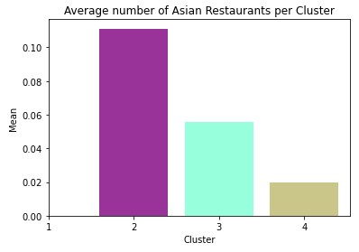
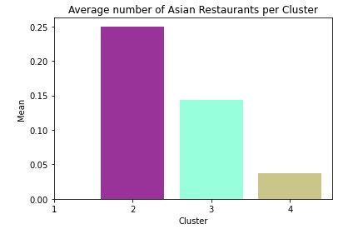
Frequency of Asian Restaurant
cluster 1 for both Edmonton and Calgary has zero frequency for Asian restaurants. Cluster two for both cities has the highest frequency, and cluster 3 and cluster 4 are next clusters for both.
Edmonton
Calgary

Slide 10
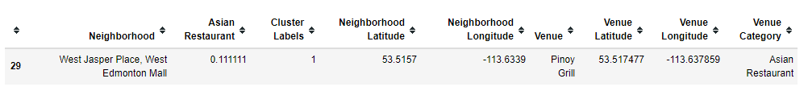
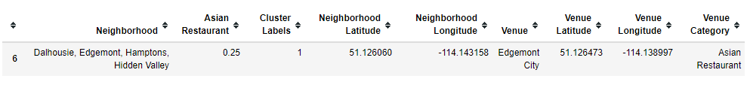
Cluster 2
Cluster 2 for Edmonton and Calgary has only one neighborhood. This cluster also has one record of Asian restaurant as well. We see that Edgemont City in the Calgary and Pinoy Grill in Edmonton are the only restaurants in cluster 2 for each city. Another important thing is that highest average of Asian restaurants is happening in cluster 2 for both of the cities with Edmonton (0.11) and Calgary (0.25).
Edmonton
Calgary

Slide 11
Cluster 3
In cluster 3 for Edmonton and Calgary there is only one Asian restaurant with an average of 0.056 in Edmonton and 0.14 in Calgary.
Edmonton
Calgary

Slide 12
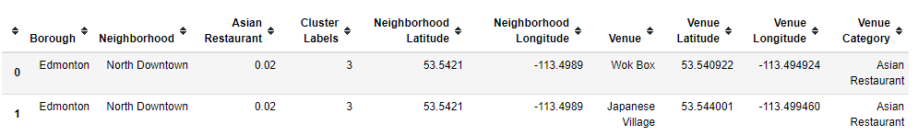
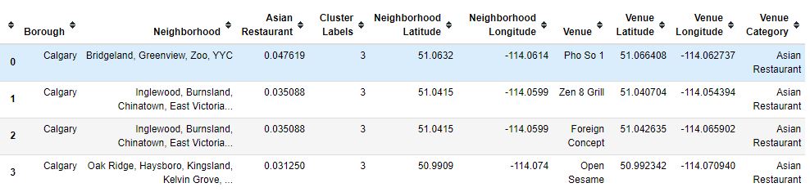
Cluster 4
In cluster 4 for Edmonton there are two Asian restaurant with an average of 0.02 and for Calgary there are four restaurant with an average of 0.03 to 0.048.
Edmonton
Calgary

Slide 13
Discussion
Most of the neighborhoods fall into cluster 1 in Edmonton and Calgary. However, there is no Asian restaurant in either cities in cluster 1.
Edmonton has 32 neighborhoods in cluster 1 with zero average of Asian restaurants in this cluster. Calgary has 29 neighborhoods in this cluster with no Asian restaurant.
Cluster 2, however, is mostly dense area with number of Asian restaurant. There is only one neighborhood in cluster 2 of Edmonton and Calgary but the average number of Asian restaurant is 0.1 for Edmonton and 0.24 for Calgary.

Slide 14
Conclusion
In this project I used python programming language with its numerous libraries, Wikipedia, foursquare, ant etc. to examine where is the best neighborhood in the city of Edmonton and city of Calgary to establish new branches of the Asian chain restaurant.
For both of the cities, neighborhoods falling into cluster 1 are the best neighborhoods to look for a place to establish a new branch of our restaurant.

